Slide 1
REVIEW
FOR Midterm!
Questions

Slide 2
Topics
Know the overall strategy of the hypothesis test: Make an assumption, gather evidence, find the probability that evidence would occur IF THE NULL WAS TRUE, make a decision.
Know the 1 and 2 sample T-Tests as well as a paired t-test. Be able to perform a complete analysis: State the Problem, Address the Assumptions, Run the Test, clearly state the conclusion / results, add a scope of inference.
Know about experimental design: Randomized Experiment v. Observational Study.
Know The Definition of Type 1 and Type 2 Error and Power.
Know the relationship between type 1 and type 2 error and power and the sample size, standard deviation and effect size.
Be able to find and interpret confidence intervals and how they are related to hypothesis tests and p-values.
Know how to perform a complete analysis with non-parametric tests. Rank-Sum, Sign-Test, Signed Rank, Etc.
Know how to perform tests with contrasts with both SAS and R.
Be very familiar with running an ANOVA and interpreting the results. (KRUSKAL-WALLIS AS WELL.)
Know Multiple Comparison Methods: Bonferroni, Tukey-Kramer, Dunnett’s

Slide 3
The Midterm!
The test is Saturday, July 21st, from 11am to 2pm CST on Zoom!
The main rule: Once the test begins, there is no communication between a student and anyone who could help that student on the exam. You may go to the bathroom anytime you like and you don’t need to ask … or anywhere else. The understanding is that students will not communicate with anyone who could help on the exam, about anything.
You should also study for this exam as if it is closed book… however, you do have access to anything except another human being that can help on the exam. This includes the HWs, the FLS slides, the videos, the book, etc. Important note: there is not time budgeted on the exam to access these items … if you are sure you know where you to look and it won’t take to long you likely have enough time for a few looks back… but too many references to other items will likely result in running out of time.
We will meet on Zoom and cameras must be kept on during the entire exam (SACCS accreditation)
At the end of the exam, simply turn submit the Word Doc to the digital campus.
If you have a question during the exam, simply private chat me the questions and I will private chat you back a response. If the entire class needs to know about the response, then I will let the class know.
Again, the main rule: Once the test begins, there is no communication between a student and anyone who could help that student on the exam. You may go to the bathroom anytime you like and you don’t need to ask … or anywhere else. The understanding is that students will not communicate with anyone who could help on the exam, about anything.

Slide 4

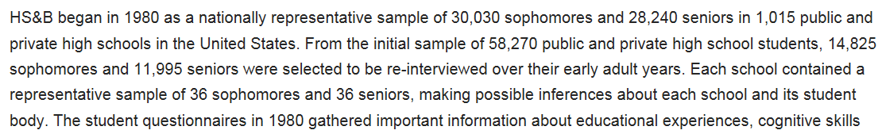

Slide 5
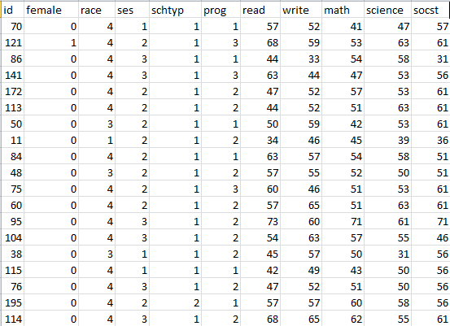
HSB2 Data Set:
This data file contains 200 observations from a sample of high school students with demographic information about the students, such as their gender (female), socio-economic status (ses) and ethnic background (race). It also contains a number of scores on standardized tests, including tests of reading (read), writing (write), mathematics (math) and social studies (socst).

Slide 6
Review!!!!
Download the HSB2 Dataset and import into a SAS or R session.
Test the claim that the mean writing score is equal to 50. Write all steps.
Test the claim that the mean writing score is different for males and females. Include all steps.
There are 4 unique race categories. Test to see if the 1st race has a different mean writing score than the 4th race.

